Slide 1
A presentation compiler
Enriched Markdown → PowerPoint and standalone HTML
Lutrin · July 2026

Slide 2
Why a compiler?
Markdown is not the final format: it is a description DSL
Content is kept separate from page layout
One canonical intermediate representation (IR)
Analysis passes: layout selection, pagination, validation
Several possible rendering engines (PPTX, HTML, PDF…)
Notes:
Stress the analogy with a classic compiler.

Slide 3
The pipeline
Front end
Back end
Enriched Markdown
markdown-it
AST → IR
Layout engine
PowerPoint scene
PptxGenJS

Slide 4
Architecture
The front end produces the IR
The layout engine places each block in a slot
Pagination splits whatever overflows
The renderer applies the brand

Slide 5
One thing at a time
The content of this slide appears on click, one step after another.
Lists reveal themselves point by point
Each block is a distinct step
Columns and sections appear as a whole
Key point
The same steps work in PowerPoint (native animations) and in the HTML preview (click on the slide).
Notes:
Demonstration of the appearance animations.

Slide 6
Comparing the approaches
Criterion | Classic converter | Compiler
Page layout | Approximate CSS | Declarative layouts
Overflow | Truncated text | Automatic pagination
Diagrams | Frozen image | AST → SVG → shapes
Theme | Style sheet | Declarative tokens
Outputs | A single one | PPTX, HTML, PDF…

Slide 7
Indicators
19
100%
0
Layouts planned
Output parity
Broken slides
↑ +5 this release
→ stable
↓ -100%
Caution
The trend on a :::metric card is colored according to its direction: ↑ turns green, ↓ turns red. The (+) suffix inverts that reflex and forces green — to say that here a fall is good news, as in "zero broken".

Slide 8
Before / after
Classic converter
Compiler
Approximate CSS, truncated text
A single output
Theme by style sheet
Declarative layouts, automatic pagination
PPTX, HTML, PDF…
Validated design tokens

Slide 9
Roadmap
1
2
3
Q3 2026
Q4 2026
Q1 2027
Structured layouts and metric trends.
Interchangeable declarative themes.
Open-source release and example gallery.

Slide 10
A layered architecture
Outputs
.pptx PowerPoint, standalone HTML, VS Code preview.
Renderers
PptxGenJS and HTML — same scene, same geometry.
Engine
Layout inference, slot placement, pagination.
IR
deck → slides → sections → blocks, source positions.

Slide 11
The project at a glance
Strengths
Weaknesses
Brand applied by construction
Two outputs, a single geometry
Embedded font ignored by Keynote
Opportunities
Threats
Themes for other organizations
Evolution of the OOXML format

Slide 12
Weighing the decision
Pros
Cons
A single source file, under version control
The brand applied by construction
A DSL to learn
Less freedom than a free-form PowerPoint

Slide 13
Filing a request, step by step
Request
Review
Answer
Online form, five minutes.
Eligibility check within 10 days.
Reasoned decision, sent by email.

Slide 14
Project portfolio
New product
Training program
Energy efficiency
Launch planned for the spring.
Three cohorts this year.
A third less consumption.

Slide 15
Request triage
2,400 received
All channels combined.
1,100 eligible
After checking the criteria.
320 selected
Funded this year.

Slide 16
Detailed roadmap
1
Q3 2026
Parameterized layouts and official catalog.
2
Q4 2026
Interchangeable declarative themes.
3
Q1 2027
Open-source release and example gallery.

Slide 17
One figure to remember
87% satisfaction
2026 survey of 2,400 respondents.

Slide 18
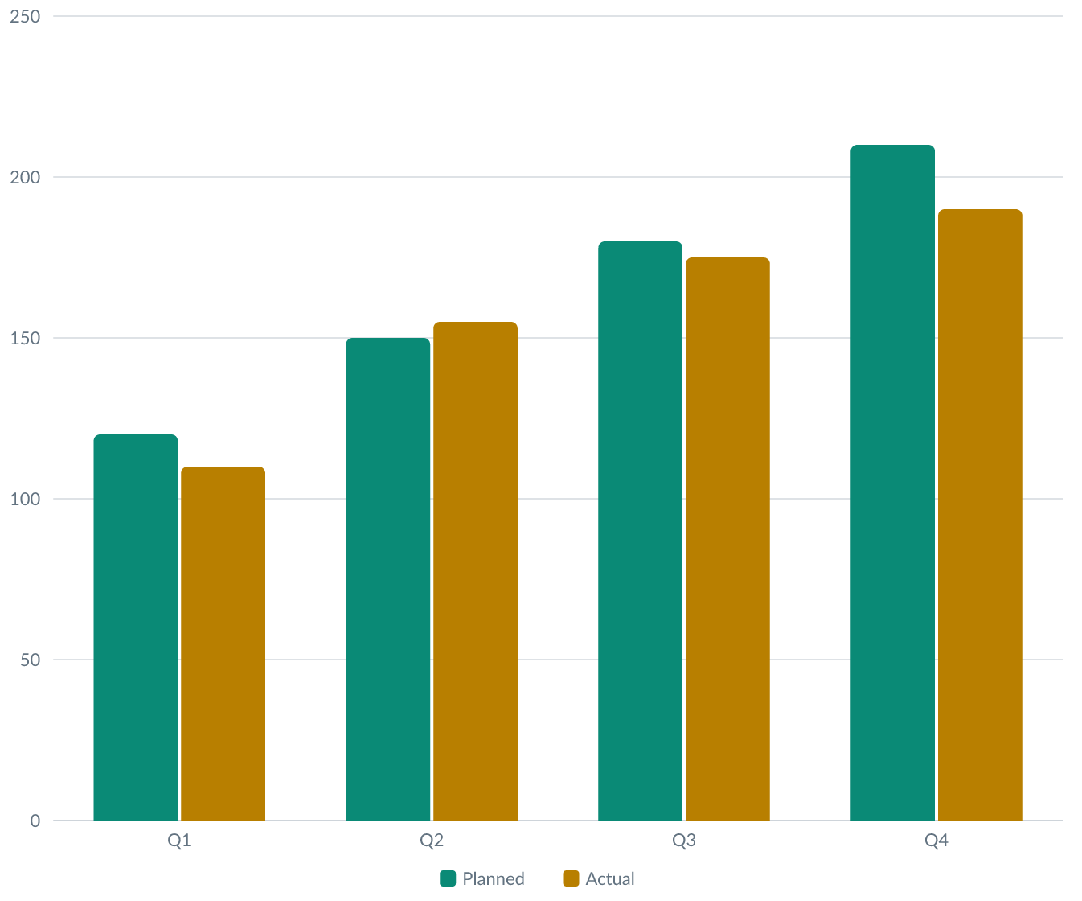
Budget by quarter
The chart is rendered by the engine, in the brand's colors, with a palette validated for color blindness and contrast.

Slide 19
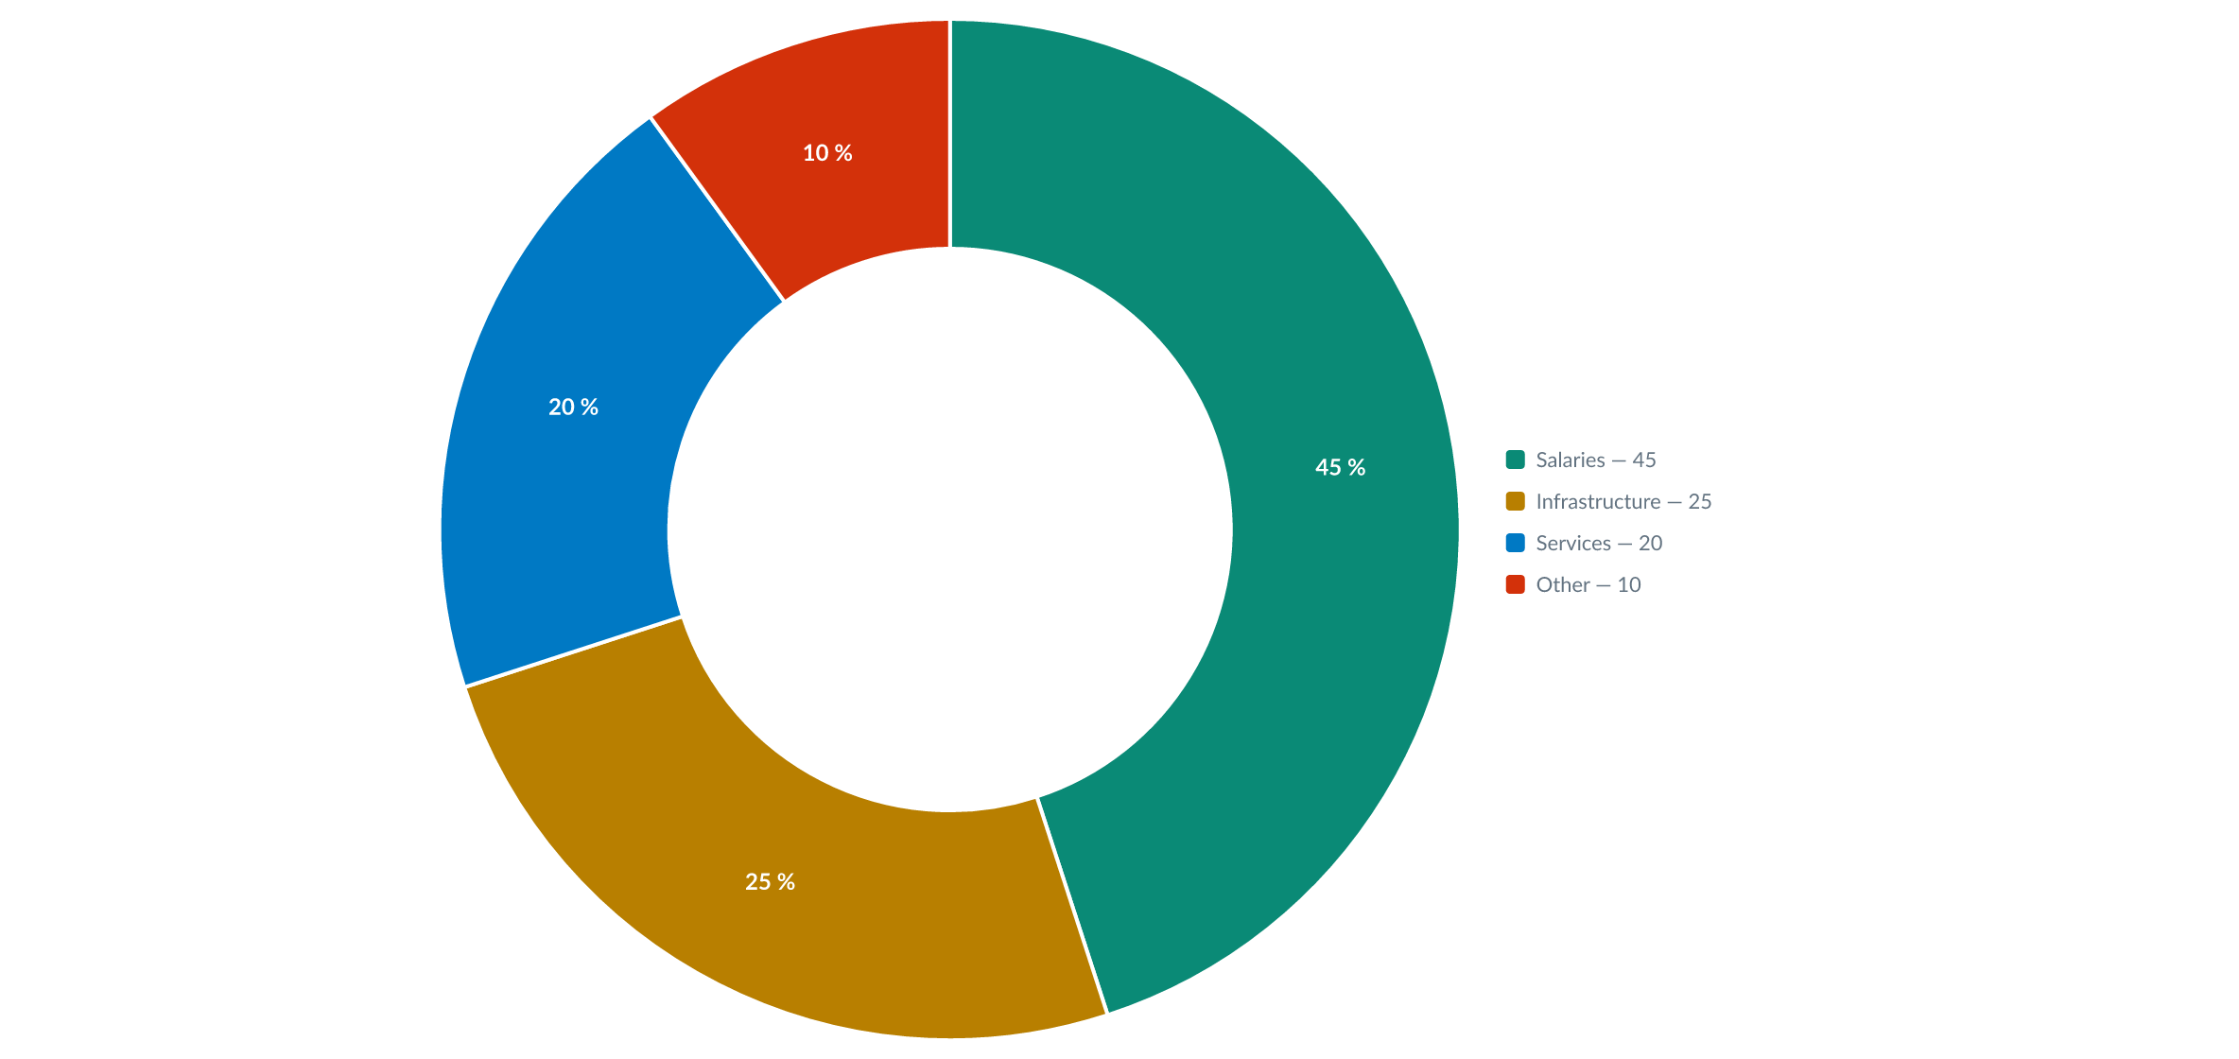
Breakdown of spending

Slide 20
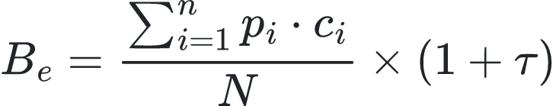
The allocation formula
The budget allocated to each team is computed as follows:
where p is the workload, c the priority coefficient and τ the annual indexation rate.

Slide 21



Three pillars
Speed
Reliability
Openness
A compile in a few seconds.
Two outputs, a single geometry.
One source file, under version control.

Slide 22
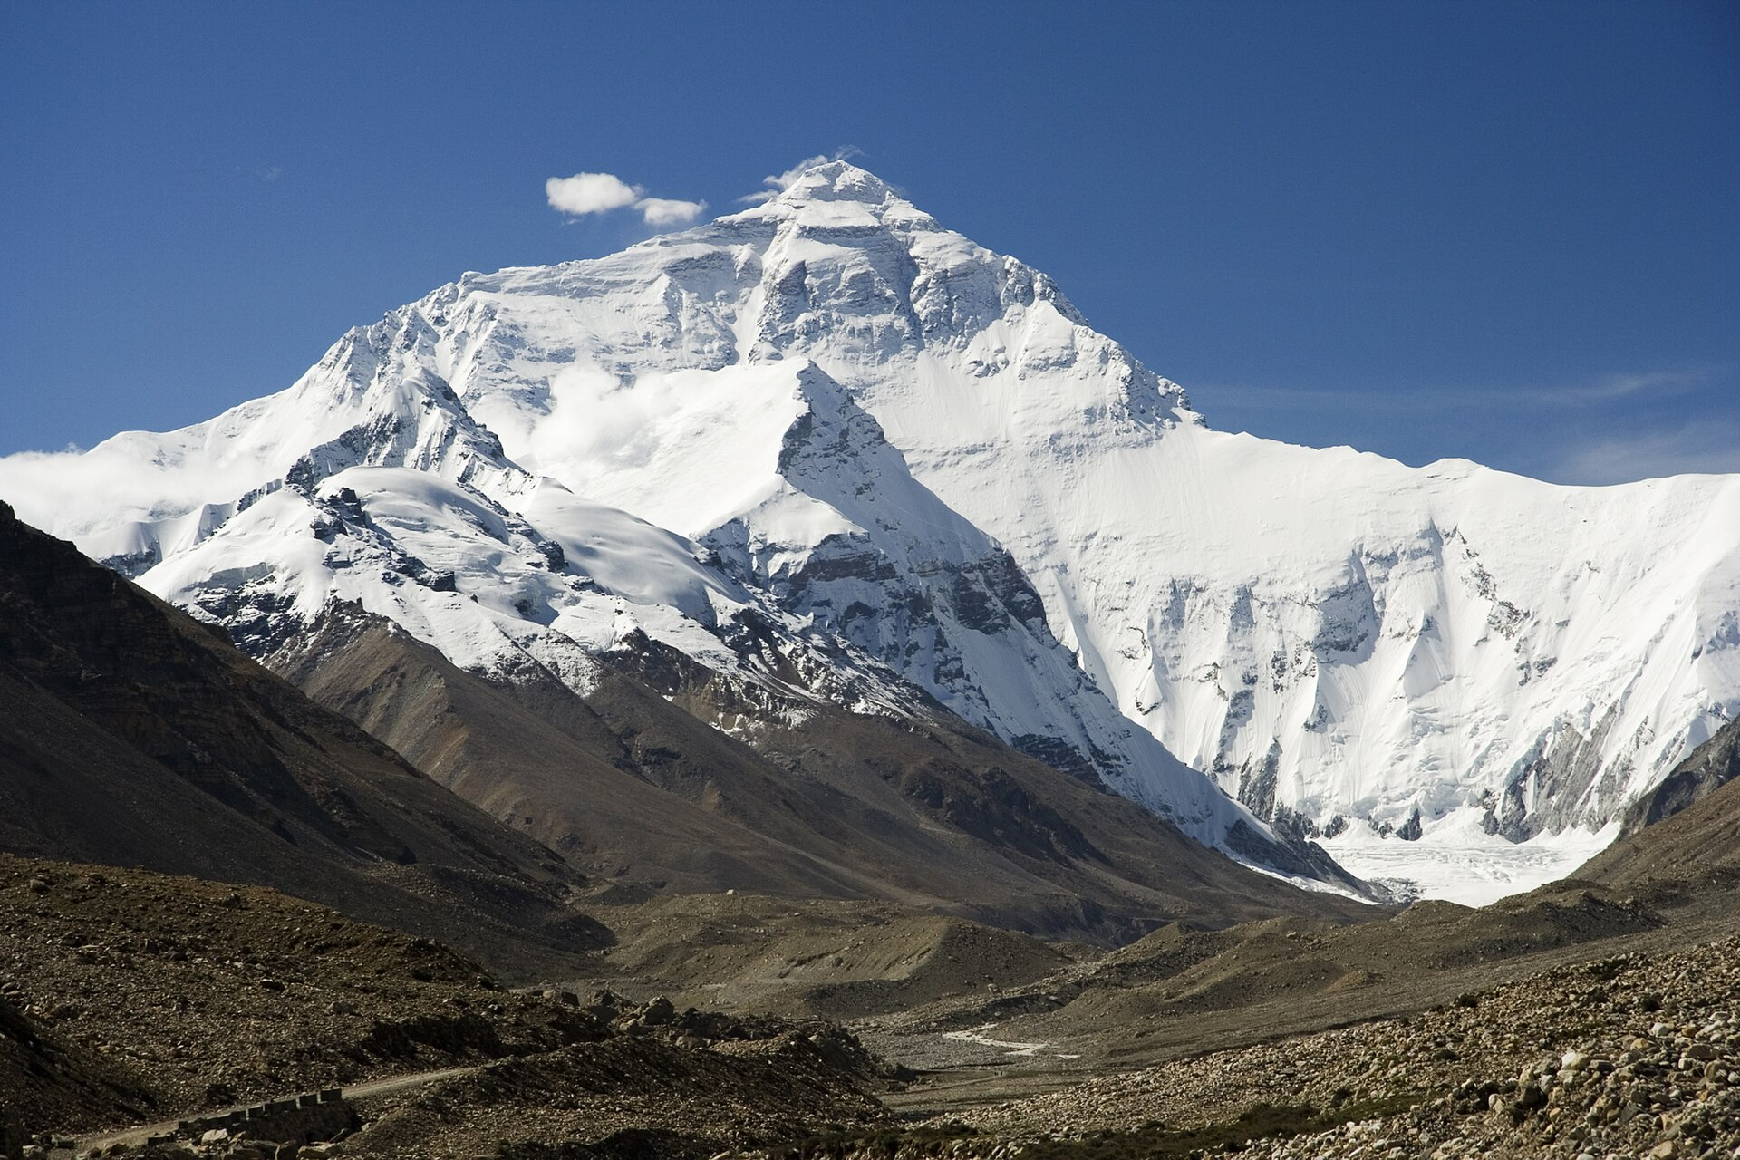
Everest, north face
A remote image: URL pasted as is into the Markdown
Downloaded into the user cache, embedded in the .pptx
Here assets: vendor: a copy kept in assets/remote/, a self-contained directory
Photo © Luca Galuzzi — www.galuzzi.it, CC BY-SA 2.5
Notes:
Photo: "Everest North Face toward Base Camp", © Luca Galuzzi - www.galuzzi.it, Wikimedia Commons, CC BY-SA 2.5. The credit must stay close to the image (the author's requirement).

Slide 23

Panorama from the Fronalpstock
Photo © Hannes Röst — Wikimedia Commons, CC BY-SA 3.0
Notes:
Photo: "Fronalpstock, Switzerland", Hannes Röst, Wikimedia Commons, CC BY-SA 3.0. hero layout: full-page image. The credit stays visible on the slide (a CC BY-SA requirement).

Slide 24
A word from users
“
You write a presentation the way you write code: a source language, an intermediate representation, optimization passes.
— A convinced author

Slide 25
The code stays readable
function compile(source: string): Deck {
const ast = parse(source); // markdown-it
const ir = lower(ast);
return layout(ir); // placement + pagination
}

Slide 26
A kit fits in a manifest
Installing an organization's brand means copying a directory. Its heart is a kit.json — data only, never code.
{
"name": "slate-plus",
"version": "1.0.0",
"theme": "./theme.json",
"layouts": "./layouts"
}

Slide 27
Next steps
Mermaid diagrams rendered as native shapes
HTML engine (reveal.js) and PDF engine (Typst)
Dynamic components (github-stats, chart, sql)
Fragments and animations
Interchangeable declarative themes
Accessibility checker (contrast, reading order)
Hot preview while editing
Example gallery
Visual regression tests
Incremental compilation cache

